Slide 1
“WEB SCRIPTING LANGUAGES”
By
Prof. K G.Walke
IT Dept.
Note: Thematerial to prepare this presentation hasbeen taken from internet and are generated only for students reference and not for commercialuse.
10 Jan 2020

Slide 2
Outline
JavaScript: Overview of JavaScript, using JSin anHTML (Embedded, External), Data types, Control Structures, Arrays, Functions and Scopes, Objects in JS,
DOM: DOM levels, DOM Objects and their properties and methods, Manipulating DOM,
JQuery: Introduction to JQuery, Loading JQuery, Selecting elements, changing styles, creating elements, appending elements, removing elements, handling events.

Slide 3
Outline
JavaScript: Overview of JavaScript, using JSin anHTML (Embedded, External), Data types, Control Structures, Arrays, Functions and Scopes, Objects in JS,
DOM: DOM levels, DOM Objects and their properties and methods, Manipulating DOM,
JQuery: Introduction to JQuery, Loading JQuery, Selecting elements, changing styles, creating elements, appending elements, removing elements, handling events.

Slide 4


JavaScript- Outline
Overview of JavaScript,
using JSin an HTML (Embedded, External),
Data types,
Control Structures,
Arrays,
Functions
Objects
Scopes

Slide 5
Overview of JavaScript,
JavaScript is one of the 3 languages all web developers must
learn:
1. HTMLto define the content of webpages
2. CSSto specify the layout of webpages
3. JavaScript to program the behavior of webpages
JavaScript is a very powerful client-side scripting language.
Javascript is a dynamic computer programming language.
•

Slide 6
JavaScript
JavaScript is a front-end scripting language developed by Mr. Brendan Eich in 1995. He was working in Netscape.(Livescript)
Lightweight, but with limitedcapabilities
Canbe used asobject-oriented language
Client-side technology
Embedded in your HTMLpage
Interpreted by the Webbrowser
Simple and flexible
Powerful to manipulate theDOM
6

Slide 7
JavaScript Advantages
JavaScript allows interactivity such as:
Implementing form validation
React to user actions, e.g. handle keys
Changing an image on moving mouse over it
Sections of a page appearing and disappearing
Content loading and changing dynamically
Performing complex calculations
Custom HTML controls, e.g. scrollable table
Implementing AJAX functionality
7

Slide 8
JavaScript Development tool
It is also called as javascript editing tool
1. Microsoft Frontpage
- Product of Microsoft. It provides various tool to create interactive websites
.
2. Macromedia Dreamweaver MX
- it provides various javascript component to handle database and support new standards XHTML & XML.
3. Macromedia Homesite 5
- product of macromedia. It helps to manage personal website.
7

Slide 9
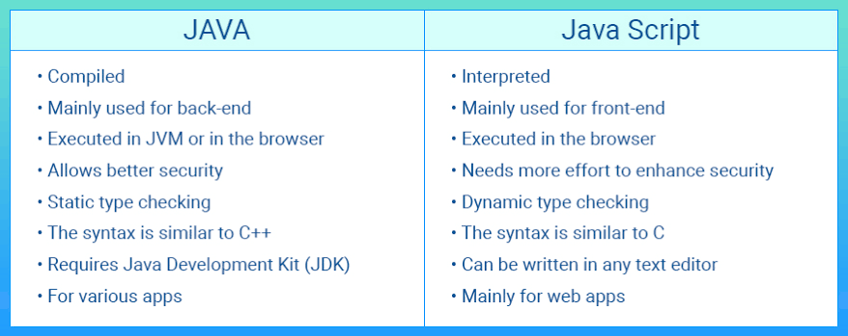
Java vs Javascripts
7

Slide 10
What Can JavaScriptDo?
Can handle events
Can read and write HTML elements
Can validate form data
Can access / modify browser cookies
Can detect the user’s browser and OS
Can be used as object-oriented language
Can handle exceptions
Can perform asynchronous server calls (AJAX)
8

Slide 11
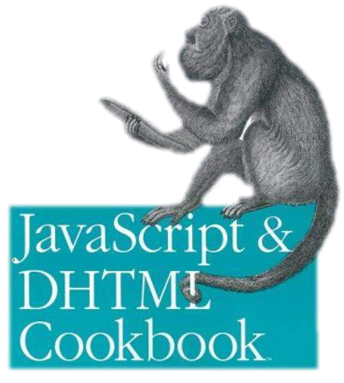

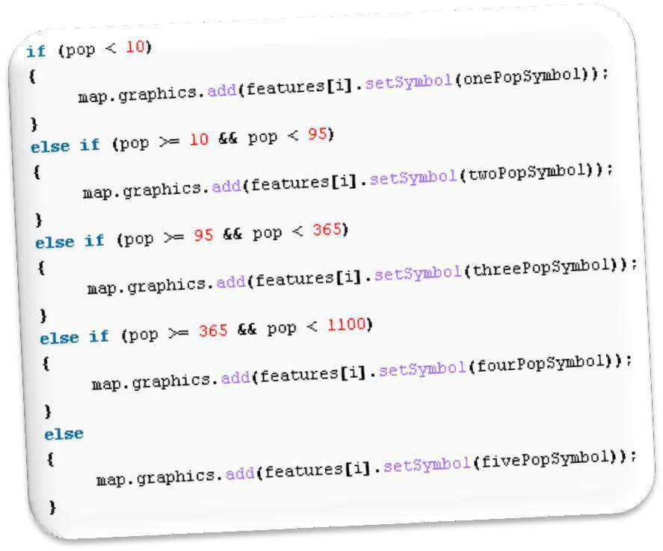



The JavaScript Syntax

Slide 12
JavaScript Syntax
JavaScript can be implemented using <script>... </script> HTML tags in a web page.
Place the <script> tags, within the <head>tags.
Syntax:
<script language="javascript" type="text/javascript">
JavaScript code
</script>

Slide 13
JavaScript Syntax
Example:
<html>
<body>
<script language="javascript" type="text/javascript">
<!--
document.write("Hello World!")
//-->
</script>
</body>
</html>
The comment ends with a "//-->". Here "//" signifies a comment in JavaScript
Output
Hello World!

Slide 14
JavaScript Syntax
The JavaScript syntax is similar to C#andJava
Operators (+, *, =, !=, &&, ++, …)
Variables (typeless)
Conditional statements (if, else)
Loops (for, while)
Arrays (my_array[]) and associative arrays (my_array['abc'])
Functions (can return value)
Function variables (like the C#delegates)
12

Slide 15
Enabling JavaScriptin Browsers
JavaScript in Firefox
Open a new tab →type about: config in the address bar.
Then you will find the warningdialog.
Select I’ll be careful, I promise!
Then you will find the list of configure options in the browser.
In the search bar, type javascript.enabled.
There you will find the option to enable or disable javascript by right-clicking on the value of that option → selecttoggle.

Slide 16
JavaScript Editor and Extension
Use Notepad to write the code
Savethe document using .html (if embedded JavaScript)
Savedocument with .js (if external JavaScript)
Run the code in brower

Slide 17
JavaScript - Placement in HTMLFile
There is a flexibility given to include JavaScript code anywhere in an HTML document.
However the most preferred ways to include JavaScript in an
HTML file are as follows−
Script in <head>...</head> section.
Script in <body>...</body> section.
Script in <body>...</body> and <head>...</head> sections.
Script in an external file and then include in
<head>...</head> section.

Slide 18
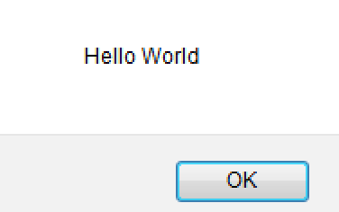
JavaScript in <head>...</head> section
<html>
<head>
<script type="text/javascript">
<!-- function sayHello()
{alert("Hello World") }
//--> </script>
</head>
<body>
<input type="button" onclick="sayHello()" value="Say Hello" />
</body>
</html>
This code will produce the following results −
Note: Comments are not displayed by the browser, but they can help document your HTML source code.

Slide 19
JavaScript in <body>...</body>
section
<html>
<head> </head>
<body>
<script type="text/javascript">
<!--
document.write("Hello World")
//-->
</script>
<p>This is web page body </p>
</body>
</html>
This code will produce the following results
−
Hello World
This is web page body

Slide 20
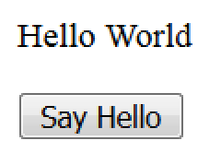
JavaScript in <body> and<head>
<html>
<head>
<script type="text/javascript">
<!-- function sayHello()
{ alert("Hello World") } //-->
</script>
</head>
<body>
<script type="text/javascript">
<!-- document.write("Hello World") //-->
</script>
<input type="button" onclick="sayHello()" value="Say Hello" />
</body> </html>
This code will produce the following result−

Slide 21
JavaScript in ExternalFile
HTMLFile
<html>
<head>
<script type="text/javascript" src="filename.js" >
</script>
</head>
<body> ....... </body>
</html>
JavaScript File – filename.js
function sayHello()
{ alert("Hello World") }

Slide 22
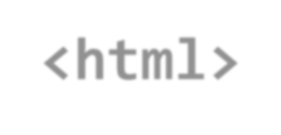


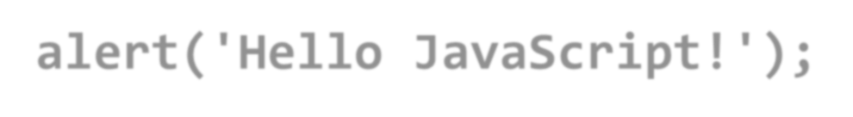
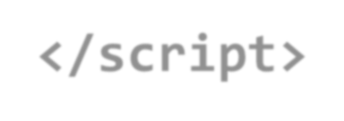

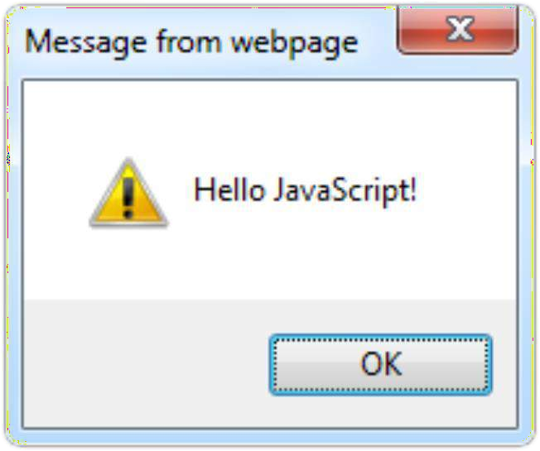

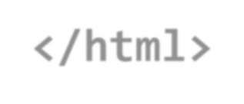
The First Script
first-script.html
<html>
<body>
<script type="text/javascript">
20
alert(' Hel l o
</ script>
</body>
Java Script!');
</html>

Slide 23
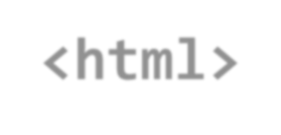



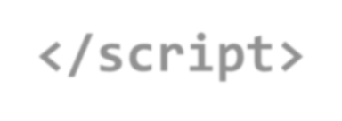

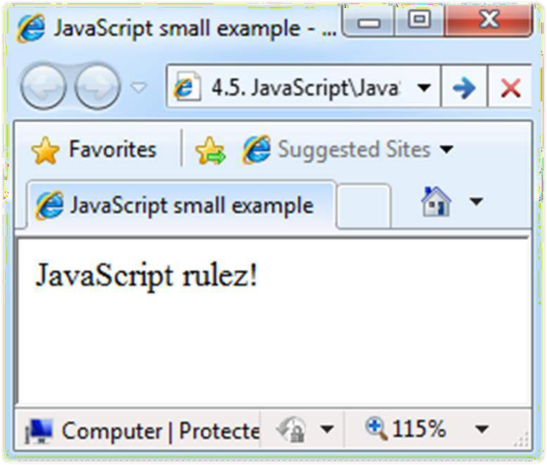

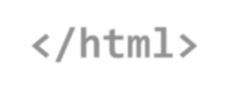
Another Small Example
small-example.html
<html>
<body>
<script type="text/javascript"> document.write('JavaScript r u l e z ! ' ) ;
</script>
</body>
</html>
21

Slide 24





Using JavaScript Code
The JavaScript code can be placed in:
<script> tag in the head
<script> tag in the body – not recommended
External files, linked via <script> tag the head
Files usually have . j s extension
Highly recommended
The . j s files get cached by the browser
22

Slide 25
JavaScript – When is Executed?
JavaScript code is executed during the page loading or whenthe browser fires an event
All statements are executed at page loading
Some statements just define functions that can be called later
Function calls or code can be attached as "event handlers" via tag attributes
Executed when the event is fired by thebrowser
23

Slide 26





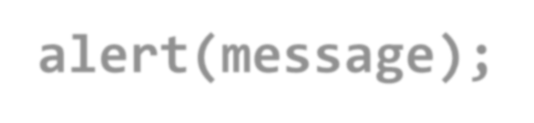
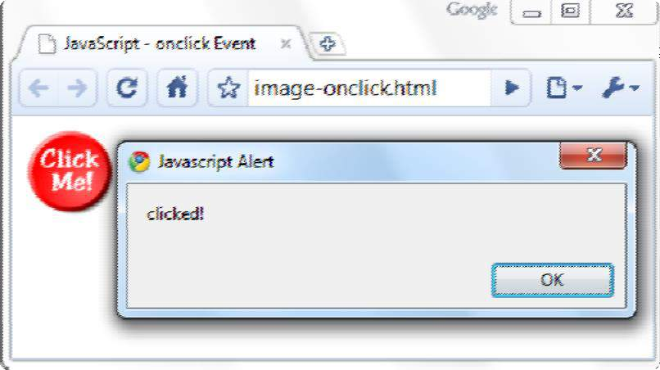




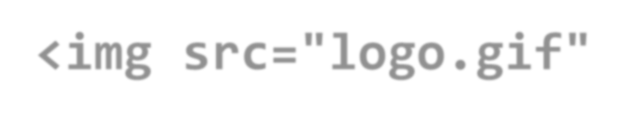



Calling a JavaScript Functionfrom Event Handler – Example
<html>
<head>
<script
image-onclick.html
type="text/javascript">
function test (message)
alert(message);
{
24
}
</ script>
</head>
<body>
<img src="logo.gif" onclick="test('clicked!')" />
</body>
</html>

Slide 27





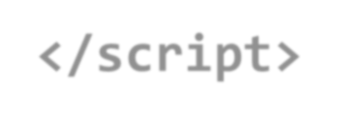




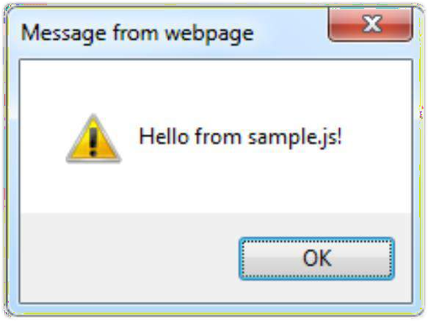


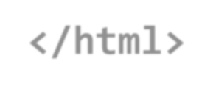
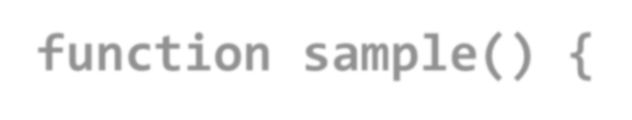



Using External Script Files
Using external script files:
<html>
<head>
external-JavaScript.html
<script src="sample.js" type="text/javascript">
</script>
</head>
<body>
The <script> tag is always empty.
25
<but t on onclick="samp le()" value="Call JavaScript function from sample.js" />
</body>
</html>
External JavaScript file:
function sample() {
alert(' Hello from sample. js!')
}
sample. j s

Slide 28

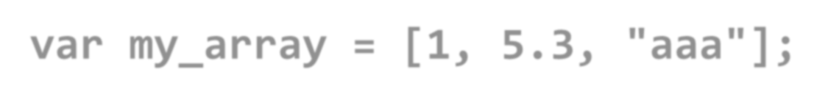
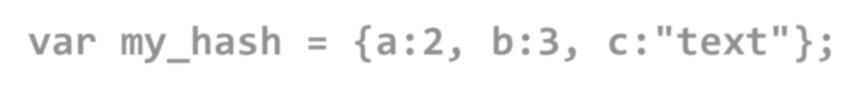
Data Types
JavaScript data types:
Numbers (integer, floating-point)
Boolean (true / false)
String type – string of characters
var myName = "You can use both single or double quotes for strings";
Arrays
26
var my_array = [ 1 , 5 . 3 , "aaa"];
Associative arrays (hash tables)
var my_hash = { a : 2 ,
b: 3 ,
c:" text"};

Slide 29
Data Types
Data types in Javascripts :
1. Primitives 2. Non-Primitives
Primitives Data Type :
String : Represent sequence of character
Number : Represent Numberic value
Boolean : boolean value either true or false
Undefined : undefined value
Null : null means no value
Non-Primitives Data Type :
Object : Represent instance, which helps to access member
Array : Represent set of same value
RegExp : Represent Regular Expression
26

Slide 30

Everything is Object
Every variable can be considered as object
For example strings and arrays have member functions:
objects.html
var test = "somes tring";
a l e r t ( t e s t [ 7 ] ) ; / / shows lette r ' r '
alert( test. char At( 5 ) ) ; / / shows l e t t e r ' s ' alert(" test". char At( 1 ) ) ; //shows l e t t e r ' e ' alert(" test". substring( 1 , 3 ) ) ; //shows ' e s '
27
var arr = [ 1 , 3 , 4 ] ;
a l e r t ( arr. length); / /
shows 3
arr. push( 7); / / appends7 to end of array
a l e r t ( a r r [ 3 ] ) ; / / shows 7

Slide 31
String Operations
The + operator joins strings
string1 = " f a t ";
string2 = "cats";
alert( string 1 + string 2 ); / / fa t
cats
28
What is "9" +9?
alert(" 9 " + 9 ) ;
/ / 99
Converting string to number:
alert( parse Int(" 9 ") + 9 ) ;
/ / 18

Slide 32
Different ways to create an Arrays
Empty array without element
var empty = [ ] ;
Array with two string element :
var days = [ S u n d a y, M o n d a y ];
29
Array with different types of element :
Var mixed = [true, 100, “ Hello”];
Two dimensional array with object literal :
Var arr = [[ 1 , { x: 10 , y: 20 }], [ 2 , { x: 30 , y: 40 }]] ;
3rd element is undefined :
Var color = [“ Red”, “ Blue”, undefined] ;
No value in 1st position : var hobbies = [ , “sports”];

Slide 33
Arrays Operations andProperties
Declaring new empty array:
var arr = new Array();
Declaring an array holding few elements:
var arr = [ 1 , 2, 3, 4, 5 ] ;
29
Appending an element / getting the last element:
arr.push(3);
var element = arr. pop();
Reading the number of elements (arraylength):
arr. length;
Finding element's index in the array:
arr. index Of( 1);

Slide 34
ARRAY METHODS
concat() Joins two or more arrays, and returns a copy of the joined arrays copyWithin( Copy array elements within the array, to and from specified positions
)
entries() Returns a key/value pair Array Iteration Object every() Checks if every element in an array pass a test fill() Fill the elements in an array with a static value
filter() Creates a new array with every element in an array that pass a test find() Returns the value of the first element in an array that pass a test findIndex() Returns the index of the first element in an array that pass a test forEach() Calls a function for each array element
from() Creates an array from an object
includes() Check if an array contains the specified element indexOf() Search the array for an element and returns its position isArray() Checks whether an object is an array
join() Joins all elements of an array into a string
keys() Returns a Array Iteration Object, containing keys of original array lastIndexOf( Search the array for an element, starting at the end, and returns its
) position

Slide 35
ARRAY METHODS
pop() | Removes the last element of an array, and returns that element
push() | Adds new elements to the end of an array, and returns the new length
reduce() | Reduce the values of an array to a single value (going left-to-right)
reduceRig ht() | Reduce the values of an array to a single value (going right-to-left)
reverse() | Reverses the order of the elements in an array
shift() | Removes the first element of an array, and returns that element
slice() | Selects a part of an array, and returns the new array
some() | Checks if any of the elements in an array pass a test
sort() | Sorts the elements of an array
splice() | Adds/Removes elements from an array
toString() | Converts an array to a string, and returns the result
unshift() | Adds new elements to the beginning of an array, and returns the

Slide 36
Standard Popup Boxes
Alert boxwith text and [OK] button
Just a message shown in a dialog box:
alert("Some text here");
30
Confirmation box
Contains text, [OK] button and [Cancel]button:
confirm("Are you sure?");
Prompt box
Contains text, input field withdefault value:
prompt ("enter amount", 10 );

Slide 37
JavaScript Variables
<script type="text/javascript">
<!--
var name = "Ali";
var money;
money = 2000.50;
//-->
</script>

Slide 38
Sum of Numbers – Example
sum-of-numbers.html
<html>
<head>
<title>JavaScript
Demo</title>
<script type="text/javascript"> funct i on calcSum() {
value1 =
par seInt(d ocument.mainFor m.textBox1. value) ; value2 =
par seInt( d ocume nt.mainFor m.textBox2. value ) ; sum = value1 + value2; document.mainForm.textBoxSum.value = sum;
}
</script>
</head>
32

Slide 39
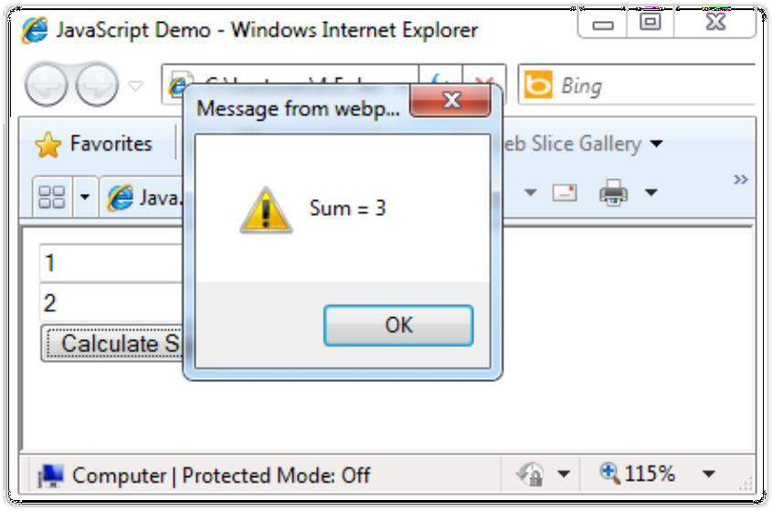

Sum of Numbers – Example (2)
sum-of-numbers.html (cont.)
<body>
<form name="mainForm">
<input type="text" name="textBox1" />
<input type="text" name="textBox2" />
<input type="button" value="Process" onclick="javascript: calcSum()" />
<input type="text" name="textBoxSum"
readonly="readonly"/>
</form>
</body>
<br/>
<br/>
33
</html>

Slide 40
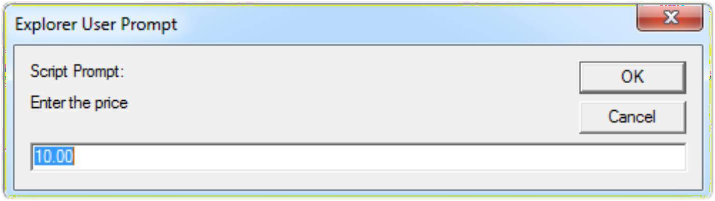

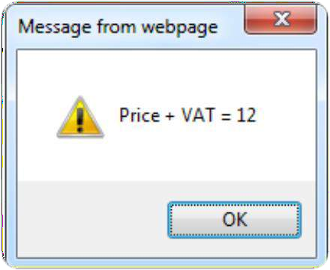

JavaScript Prompt – Example
prompt.html
price = prompt("Enterthe price", "10.00");
1 . 2 ) ;
alert(' Pri c e + VAT = ' + price *
34

Slide 41
JavaScript - Operators
Arithmetic Operators
Comparison Operators
Logical (or Relational) Operators
Assignment Operators
Conditional (or ternary) Operators

Slide 42


















Conditional Statement ( i f )
unitPrice = 1 . 30 ;
i f (quantity > 100) {
unitPrice = 1.20;
}
36
Symbol | Meaning
> | Greater than
< | Less than
>= | Greater than or equal to
<= | Lessthan or equal to
== | Equal
!= | Not equal

Slide 43


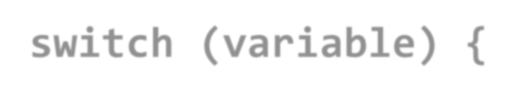










Switch Statement
The switch statement works like in C#:
switch ( variable) {
case 1:
/ / do something break;
case ' a ' :
/ / do something else
break; case 3 . 14 :
/ / another code
break;
default:
switch-statements.html
37
/ / something completely different
}

Slide 44
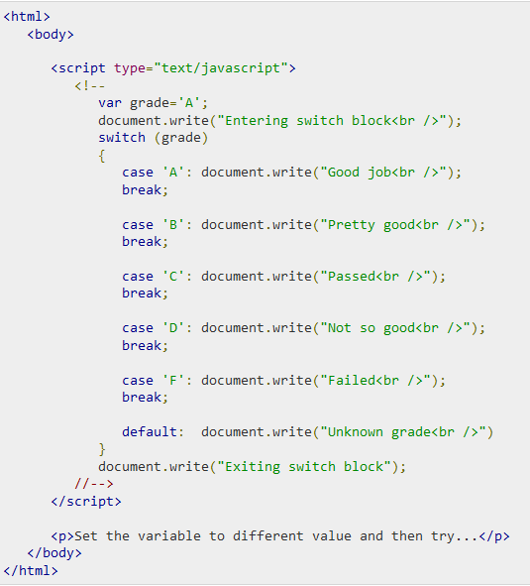
Switch case Example

Slide 45
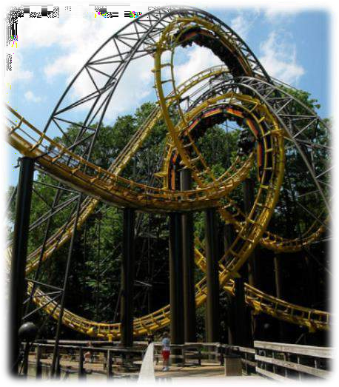














Loops
Like in C#
f o r loop
while loop
do … while loop
var counter;
for (counter=0; counter<4; counter++)
{
alert( counter);
39
}
while (counter < 5)
{
alert(++counter);
}
loops.html

Slide 46
While-loop Example
<html>
<body>
<script type="text/javascript">
<!-- var count = 0;
document.write("Starting Loop ");
while (count < 10){
document.write("Current Count : " + count + "<br />"); count++; }
document.write("Loop stopped!");
//--> </script>
<p>Set the variable to different value and then try...</p>
</body> </html>

Slide 47








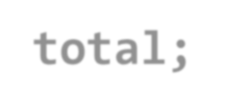


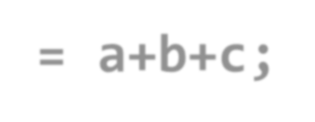







Functions
Code structure – splitting code into parts
Data comes in, processed, result returned
Parameters come in here.
41
function average(a,
{
var t o t a l ;
t o t a l = a+b+c; return t o t a l / 3 ;
b, c)
Declaring variables is optional. Type is never declared.
}
Value returned here.

Slide 48

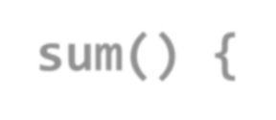

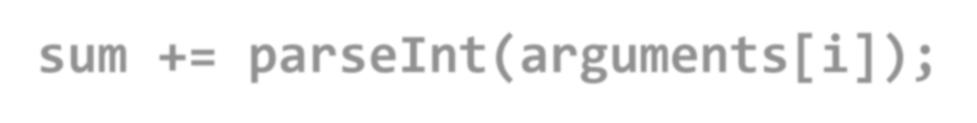


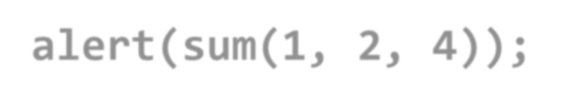



Function Arguments & ReturnValue
Functions are not required to returna value
When calling function it is not obligatory to specify all of its arguments
The function has access to all the arguments passed via arguments array
function sum() { var sum = 0;
for ( var i = 0; i < arguments . l ength; i ++) sum += parseInt(arguments[i]);
return sum;
}
alert(sum(1, 2, 4 ) ) ;
functions-demo.html
42

Slide 49
JavaScript Function Syntax
function name(parameter1, parameter2, parameter3) {
code to be executed
}
var x = myFunction(4, 3); // Function is called, return value will end up in x
function myFunction(a, b) {
return a * b;
and b
}
// Function returns the product of a

Slide 50
Object in JavaScript
An object is nothing but an entity having its own state and
behaviour (properties and methods).
e.g. Flower is an object having properties like color, fragrance etc
Ways to create object in JavaScripts :
By object Literal : property and value is seperated by seperator : (colon)
Syntax: object = {property1 = value, property2: value……..}
By creating instance of object directly New keyword is used to create object Syntax : var objectname=new Object();
By using an object constructor
This keyword is used to refer current object.
Syntax : this.Object(variable name) e.g. this.id

Slide 51
Outline
JavaScript: Overview of JavaScript, using JSin anHTML (Embedded, External), Data types, Control Structures, Arrays, Functions and Scopes, Objects in JS,
DOM: DOM levels, DOM Objects and their properties and methods, Manipulating DOM,
JQuery: Introduction to JQuery, Loading JQuery, Selecting elements, changing styles, creating elements, appending elements, removing elements, handling events.

Slide 52
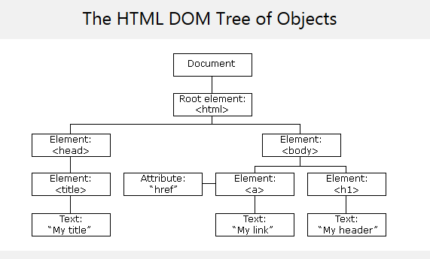
DOM-Document Object Mode
When aweb page is loaded, the browser creates a Document Object
Model of thepage.
The HTMLDOM model is constructed asa tree of Objects:

Slide 53
Benefits of DOMto JavaScript
With the object model, JavaScript gets all the power it needs to create
dynamic HTML:
JavaScript can change all the HTML elements in the page
JavaScript can change all the HTML attributes in the page
JavaScript can change all the CSSstyles in the page
JavaScript can remove existing HTML elements and attributes
JavaScript can add new HTML elements and attributes
JavaScript can react to all existing HTML events in the page
JavaScript can create new HTML events in the page

Slide 54
What is theDOM?
The DOM is a W3C (World Wide Web Consortium) standard.
The DOM defines a standard for accessing documents:
"The W3C Document Object Model (DOM) is a platform and language- neutral interface that allows programs and scripts to dynamically access and update the content, structure, and style of a document.“
The W3C DOM standard is separated into 3 different parts:
Core DOM - standard model for all documenttypes
XML DOM - standard model for XMLdocuments
HTML DOM - standard model for HTMLdocuments

Slide 55
DOMLevels
DOM Level 1
DOM Level 2
DOM Level 3
For More details regarding DOM levels click on belowsite.
https://developer.mozilla.org/fr/docs/DOM_Levels

Slide 56
DOMLevel 1
The DOM Level 1 specification is separated into two parts:
Core and
HTML.
Core Level 1 provides a low-level set of fundamental interfaces that can represent any structured document, as well as defining extended interfaces for representing anXML document.
HTML Level 1 provides additional, higher-level interfaces that are used with the fundamental interfaces defined in Core Level 1 to provide a more convenient view of an HTML document. Interfaces introduced in DOM1 include, among others, the Document, Node, Attr, Element, and Text interfaces.

Slide 57
DOMLevel 2
The DOM Level 2 specification contains six different
specifications:
The DOM2 Core,
Views,
Events,
Style,
Traversal and Range, and
the DOM2 HTML. Most of the DOM Level 2 is supportedin
Mozilla.

Slide 58
DOMLevel 2
Specification | Description
DOM Level 2 Core | helps the programs and scripts to access and update the content and structure of documentdynamically
DOM Level 2 Views | allows programs and scripts to dynamically accessand update the content of an HTML or XMLdocument
DOM Level 2 Events | provides a generic event system to programs and scripts
DOM Level 2 Style | allows programs and scripts to dynamically accessand update the content of stylesheets
DOM Level 2 Traversal and Range | allows programs and scripts to dynamically traverse and identify a range of content in adocument
DOM Level 2 HTML | allows programs and scripts to dynamically accessand update the content and structure of HTML 4.01 and XHTML 1.0 documents

Slide 59
DOMLevel 3
The DOM Level 3 specification contains five different specifications:
The DOM3 Core,
Load and Save,
Validation,
Events, and
XPath.

Slide 60
DOMLevel 3
Specification | Description
DOM Level 3 Core | allows programs and scripts to dynamically accessand update the content, structure, and documentstyle
DOM Level 3 Load and Save | allows programs and scripts to dynamically loadthe content of an XML document into a DOM document
DOM Level 3 Validation | allows programs and scripts to dynamically updatethe content and structure of documents and ensures that the document remains valid

Slide 61
DOMObjects and their properties and methods
In the DOM, all HTMLelements are defined asobjects.
The programming interface is the properties and methods of object.
HTMLDOM properties are values (of HTMLElements) that you can set or change.
each
HTML DOM methods are actions you can perform (on HTML Elements). A method is an action you can do (like add or deleting an HTMLelement).

Slide 62

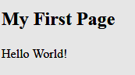
DOMExample 1
The following example changes the content (the innerHTML) of the
<p> element with id="demo":
Example
<html>
<body>
<p id="demo"></p>
Output
<script>
document.getElementById("demo").innerHTML = "Hello World!";
</script>
</body>
</html>
In the example above, getElementById is a method, while innerHTML is a property.

Slide 63
getElementById & innerHTML
ThegetElementById Method
The most common way to access an HTML element is to use the id of the
element.
In the example above the getElementById method used id="demo" to find theelement.
TheinnerHTML Property
The easiest way to get the content of an element is by using the innerHTML
property.S
The innerHTML property is useful for getting or replacingthe content of HTMLelements.
The innerHTML property can be used to get or change any HTML element, including <html> and <body>.

Slide 64
Finding HTMLElements
Method | Description
document.getElementById(id) | Find an element by element id
document.getElementsByTagName(name) | Find elements by tag name
document.getElementsByClassName(name) | Find elements by class name

Slide 65
Changing HTMLElements
Method | Description
element.innerHTML = new htmlcontent | Change the inner HTML of an element
element.attribute = new value | Change the attribute value of an HTML element
element.setAttribute(attribute, value) | Change the attribute value of an HTML element
element.style.property = new style | Change the style of an HTML element

Slide 66
Adding and DeletingElements
Method | Description
document.createElement(element) | Create an HTML element
document.removeChild(element) | Remove an HTML element
document.appendChild(element) | Add an HTML element
document.replaceChild(element) | Replace an HTML element
document.write(text) | Write into the HTML output stream

Slide 67
Adding Events Handlers
Method | Description
document.getElementById(id).onclick = function(){code} | Adding event handler code to an onclick event

Slide 68
Finding HTMLObjects
Property | Description | DOM
document.baseURI | Returns the absolute base URI of the document | 3
document.body | Returns the <body> element | 1
document.cookie | Returns the document's cookie | 1
document.doctype | Returns the document's doctype | 3
document.forms | Returns all <form> elements | 1
document.head | Returns the <head> element | 3
document.images | Returns all <img> elements | 1

Slide 69
Changing HTMLContent
Example
<html> <body>
<h2>JavaScript can Change HTML</h2>
<p id="p1">Hello World!</p>
<script>
document.getElementById("p1").innerHTML ="New text!";
</script>
<p>The paragraph above was changed by ascript.</p>
</body> </html>
Output
JavaScriptcanChange HTML
New text!
The paragraph above was changed by ascript.

Slide 70
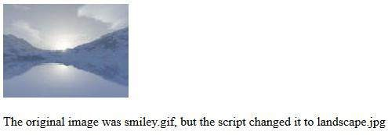
Changing the Value of an Attribute
Example
<html><body>
<img id="image" src="smiley.gif" width="160" height="120">
<script>
document.getElementById("image").src ="landscape.jpg";
</script>
<p>The original image was smiley.gif, but the script changed itto
landscape.jpg</p>
</body></html>
Output

Slide 71
Outline
JavaScript: Overview of JavaScript, using JSin anHTML (Embedded, External), Data types, Control Structures, Arrays, Functions and Scopes, Objects in JS,
DOM: DOM levels, DOM Objects and their properties and methods, Manipulating DOM,
JQuery: Introduction to JQuery, Loading JQuery, Selecting elements, changing styles, creating elements, appending elements, removing elements, handling events.

Slide 72
jQuery - Introduction
jQuery is a JavaScript Library.
jQuery greatly simplifies JavaScriptprogramming.
jQuery is alightweight
jQuery also simplifies a lot of the complicated thingsfrom JavaScript, like
AJAXcalls and DOMmanipulation.
The jQuery library contains the followingfeatures:
HTML/DOM manipulation
CSSmanipulation
HTMLevent methods
Effects and animations
AJAX

Slide 73
Adding jQuery to YourWeb Pages
There are several ways to start using jQuery on yourweb site. Youcan:
Download the jQuery library fromjQuery.com
Include jQuery from a CDN,like Google

Slide 74
Downloading jQuery
There are two versions of jQuery available fordownloading:
Production version - this is for your live website because it has been minified and compressed
Development version - this is for testing anddevelopment
Both versions can be downloaded from jQuery.com.
The jQuery library is a single JavaScript file, and you reference it with the HTML <script> tag (notice that the <script> tag should be inside the <head> section):
<head>
<script src="jquery-3.2.1.min.js"></script>
</head>
Tip: Place the downloaded file in the same directory as the pages where you wish to useit.

Slide 75
jQuery CDN
If you don't want to download and host jQuery yourself, you can
include it from a CDN(Content Delivery Network).
Both Google and Microsoft host jQuery.
Touse jQuery from Google or Microsoft, use one of the following:
Google CDN:
<head>
<script src="https://ajax.googleapis.com/ajax/libs/jquery/3.2.1/jquery.min.js ">
</script>
</head>

Slide 76
jQuery Syntax
With jQuery you select (query) HTMLelements and perform "actions" on them.
syntax :
$(selector).action()
A$ sign to define/access jQuery
A(selector) to "query (or find)" HTMLelements
AjQuery action() to be performed on theelement(s)
Examples:
$(this).hide() - hides the currentelement.
$("p").hide() - hides all <p>elements.
$(".test").hide() - hides all elements withclass="test".
$("#test").hide() - hides the element withid="test".

Slide 77
jQuery Selectors-Selecting elements
jQuery selectors allow you to select and manipulate HTML element(s).
jQuery selectors are used to "find" (or select) HTML elements based on their name, id, classes, types, attributes, values of attributes and much more. It's based on the existing CSS Selectors, and in addition, it has some owncustom selectors.
All selectors in jQuery start with the dollar sign and
parentheses: $().

Slide 78
The element Selector
The jQuery element selector selects elements based on the element
name.
Youcan select all <p> elements on a page like this:
$("p")
Example
When a user clicks on a button, all <p> elements will be hidden:
$(document).ready(function(){
$("button").click(function(){
$("p").hide();
});
});

Slide 79
The #id Selector
The jQuery #id selector uses the id attribute of an HTMLtag tofind the specific element.
An id should be unique within a page, so you should use the#id selector when you
want tofind a single, unique element.
Tofind an element with a specific id, write a hashcharacter, followed by the id ofthe HTMLelement:
$("#test")
Example
When auser clicks on abutton, the element with id="test" will be hidden:
$(document).ready(function(){
$("button").click(function(){
$("#test").hide();
});
});

Slide 80

jQuery css()Method- Changing Style
jQuery css() Method
The css() method sets or returns one or morestyle properties for the selectedelements.
Return a CSSProperty
Toreturn the value of aspecified CSSproperty, use the following syntax:
css("propertyname");
Set a CSSProperty
Toset a specified CSSproperty, use the following syntax:
css("propertyname","value");

Slide 81






Changing Style-
Return a CSS PropertyExample
<html><head>
<script src="https://ajax.googleapis.com/ajax/libs/jquery/3.2.1/jquery.min.js"></sc ript>
<script>
$(document).ready(function(){
$("button").click(function(){
alert("Background color =" +$("p").css("background-color"));
});
});
</script>
</head><body>
<p style="background-color:#ff0000">This is a paragraph.</p>
<button>Return background-color of p</button>
</body></html>

Slide 82




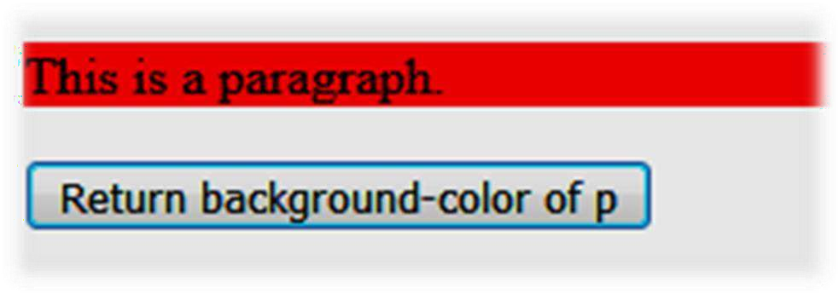

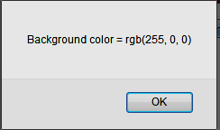
Changing Style-
Return a CSS Property Exampleo/p
Output of Previous Code

Slide 83





Changing Style-
Set a CSS PropertyExample
<html><head>
<script
src="https://ajax.googleapis.com/ajax/libs/jquery/3.2.1/jquery.min.js"></script>
<script>
$(document).ready(function(){
$("button").click(function(){
$("p").css("background-color", "yellow");
});
});
</script>
</head>
<body>
<p style="background-color:#ff0000">This is a paragraph.</p>
<button>Set background-color of p</button>
</body></html>

Slide 84



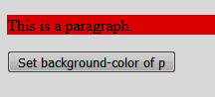

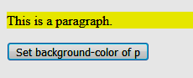
Changing Style-
Set a CSS Property Exampleo/p
Output of Previous Code
After clicking on button

Slide 85
jQuSery - AddElements
We will look at four jQuery methods that are used to add new content:
append() - Inserts content at the end of the selected elements
prepend() - Inserts content at the beginning of the selected elements
after() - Inserts content after the selectedelements
before() - Inserts content before the selectedelements

Slide 86


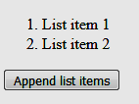

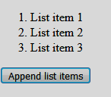
jQuery append() Method-Example
<html><head>
<script src="https://ajax.googleapis.com/ajax/libs/jquery/3.2.1/jquery.min.js"></scrip t>
<script>
$(document).ready(function(){
$("#btn1").click(function(){
$("ol").append("<li> List item 3 </li>");
}); }); </script>
</head>
<body>
<ol>
<li>List item 1</li>
<li>List item 2</li>
</ol>
After Clicking on button
<button id="btn1"> Append list items </button>
</body></html>

Slide 87
jQuery - RemoveElements
Remove Elements/Content
Toremove elements and content, there are mainly two jQuery methods:
remove() - Removes the selected element (and its child elements)
empty() - Removes the child elements from the selected element

Slide 88

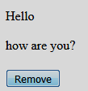

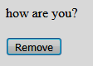
jQuery remove() Method-Example
<html > <head>
<script src="https://code.jquery.com/jquery-1.10.2.js">
</script>
</head>
<body>
<p>Hello</p>
how are you?
<button>Remove </button>
<script>
$( "button" ).click(function() {
$( "p" ).remove();
});
</script>
</body></html>
After Clicking on button

Slide 89
References
https://www.slideshare.net/rakhithota/js-ppt
https://www.tutorialspoint.com/javascript/javascript_quic k_guide.htm
https://www.w3schools.com/js
https://www.w3schools.com/js/js_htmldom.asp
https://developer.mozilla.org/fr/docs/DOM_Levels
https://codescracker.com/js/js-dom-levels.htm
https://www.w3schools.com/jquery/jquery_get_started.a sp
https://www.w3schools.com/jquery/jquery_css.asp
https://www.w3schools.com/jquery/jquery_dom_add.asp

Slide 90
Thank You
gharu.anand@gmail.com Blog : anandgharu.wordpress.com
Prof. Gharu Anand N.
90 90

